Slide 1
FreeETarget
Opensource Electronic Scoring Sysgtem

Slide 2
What is FreeETarget
FreeETarget is an open source project to make a low cost ESS
Three options for making the target with prices ranging from $200 to $495
Use your own laptop or PC for display
Features for scoring and training

Slide 3
Features
Open source – Build it yourself
Conventional target scoring for a range of targets
Rapid fire pistol training
Tabata timer
WiFi network for multiple viewers
No score option for process training

Slide 4
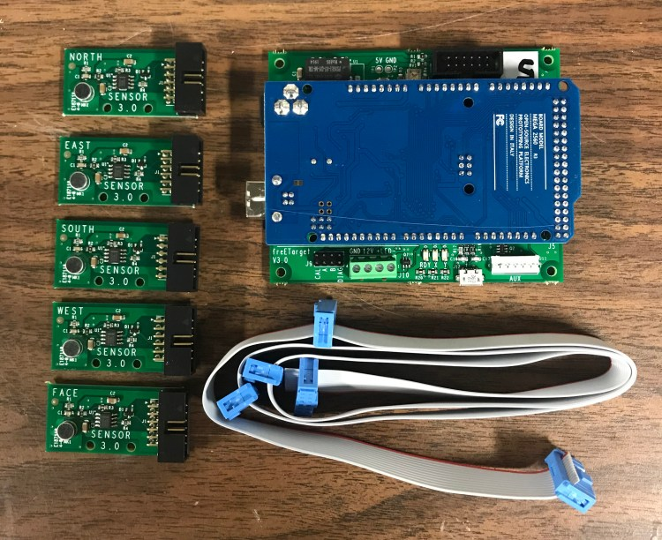
Options – Do It Yourself
Do It Yourself (DIY)
Buy the circuit and build the rest yourself.
Drawings and 3D parts available

Slide 5
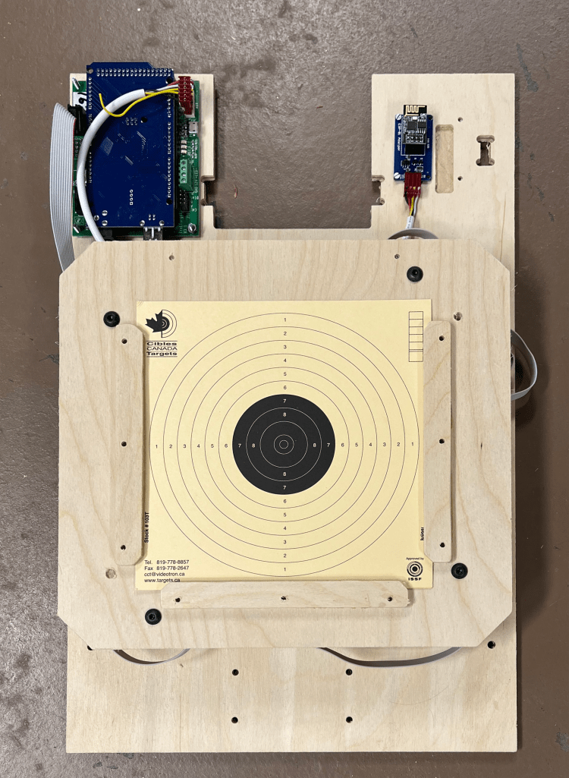
Club Target Kit
Bare bones ESS
Includes
Circuit
Sensor mounts
Generic target holder (wood)
Options
WiFi
Metal target holder
Witness paper drive

Slide 6
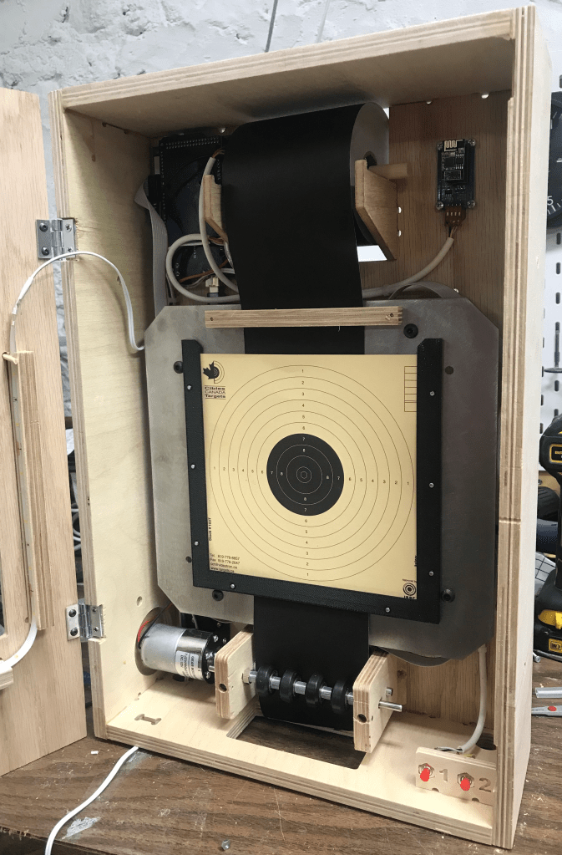
Competition Target Kit
Full featured ESS
Includes
Circuit
Motor drive
Metal target plate
Housing
Not included
LED lights
WiFi

Slide 7
PC Program
Provide your own PC
Download the software from free-e-target.com
Video FreeETarget PC Client

Slide 8
Costs
Part | Description | Cost
Circuit | Basic circuit, build the rest | $200
WiFi | WiFi adapter and cable | $30
Witness paper drive | Used to improve accuracy | $105
Club target | Low cost ESS includes circuit Includes generic target holder | $295
Option metal pistol plate |  | $45
Option metal rifle plate |  | $45
Competition target | Circuit, witness paper drive, choice of target plates LED lights and glue not included | $495

Slide 9
Questions?
Please visit free-e-target.com for
Techinical documentation
Downloads
User stories
Email freeetarget@gmail.com
Join freetarget on Facebook https://www.facebook.com/groups/831490281129882

